Slide 1
Recording in session
Notes:
Press the Record button.
This virtual session is being recorded.

Slide 2
BUDGET PROJECTIONS
2024-2027 Three-Year LCAP Development
LCAP | Educational Partner Engagement | February 16, 2024

Slide 3
Recording in session
Notes:
Press the Record button.
This virtual session is being recorded.

Slide 4
Welcome
Welcome / Opening
Superintendent Dr. Michelle Rodriguez
English: https://www.stocktonusd.net/cms/lib/CA01902791/Centricity/Domain/142/SUSD%20State%20of%20the%20District%202023%20-%20English.pdf
Spanish:
https://www.stocktonusd.net/cms/lib/CA01902791/Centricity/Domain/142/SUSD%20State%20of%20the%20District%202023%20-%20Spanish.pdf
“ALL OF SUSD”
Dashboard
www.allofsusd.net
https://www.stocktonusd.net/Page/17757

Slide 5
AGENDA
Session Focus: Budget Projections
Topics:
Superintendent’s Welcome
LCAP Engagement In 2023-2024
Prior Engagement Session Recap
Opportunities to Build Trust Through Authentic Engagement
* 2023-2024 LCAP Review and Feedback Survey
Budget Projections
Next LCAP Engagement Session

Slide 6
LCAP Engagement in 2023-2024
11/28: Introduction: LCAP Fundamentals
12/04: Current District Priorities – 2023-2024 School Year
01/19: LCAP Mid-Year Update and Funding
02/09: Data Analysis / District Areas of Need
02/16: Budget Projections
03/05: Survey Results and Key Findings
03/08: Identified District Goals/Activities
* April 2024: Post Draft 2024-2027 LCAP
* May 2024: Public Hearing 2024-2027 LCAP
* June 2024: Board Adoption 2024-2027 LCAP

Slide 7
Prior engagement session recap
CIRCLING
BACK

Slide 8
Prior engagement session topics
Topics Presented:
LCAP Requirements and Components
LCAP and School Plan for Student Achievement (SPSA) Alignment
Connecting 2023-2024 District Priorities
Mid-Year Update and Funding Overview
Data Analysis / District Areas of Need
Missed the Session?
SUSD recorded the Zoom LCAP Engagement Session for post meeting review at your convenience.
These recordings and the presentations are available on the district’s LCAP webpage: https://www.stocktonusd.net/Page/16289
The district’s current (and past) LCAP is available too.

Slide 9
Opportunities to build trust Through Authentic Engagement
YOUR
VOICE
MATTERS!

Slide 10
2023-2024 LCAP REVIEW AND FEEDBACK SURVEY
ENGLISH
SPANISH
bit.ly/comentariosdelLCAP23-24
Notes:
https://forms.gle/1sTAQWjX1s71NkCb8
bit.ly/comentariosdelLCAP23-24

Slide 11
Budget projections
Estimate of potential expenditures for a future period of time

Slide 12
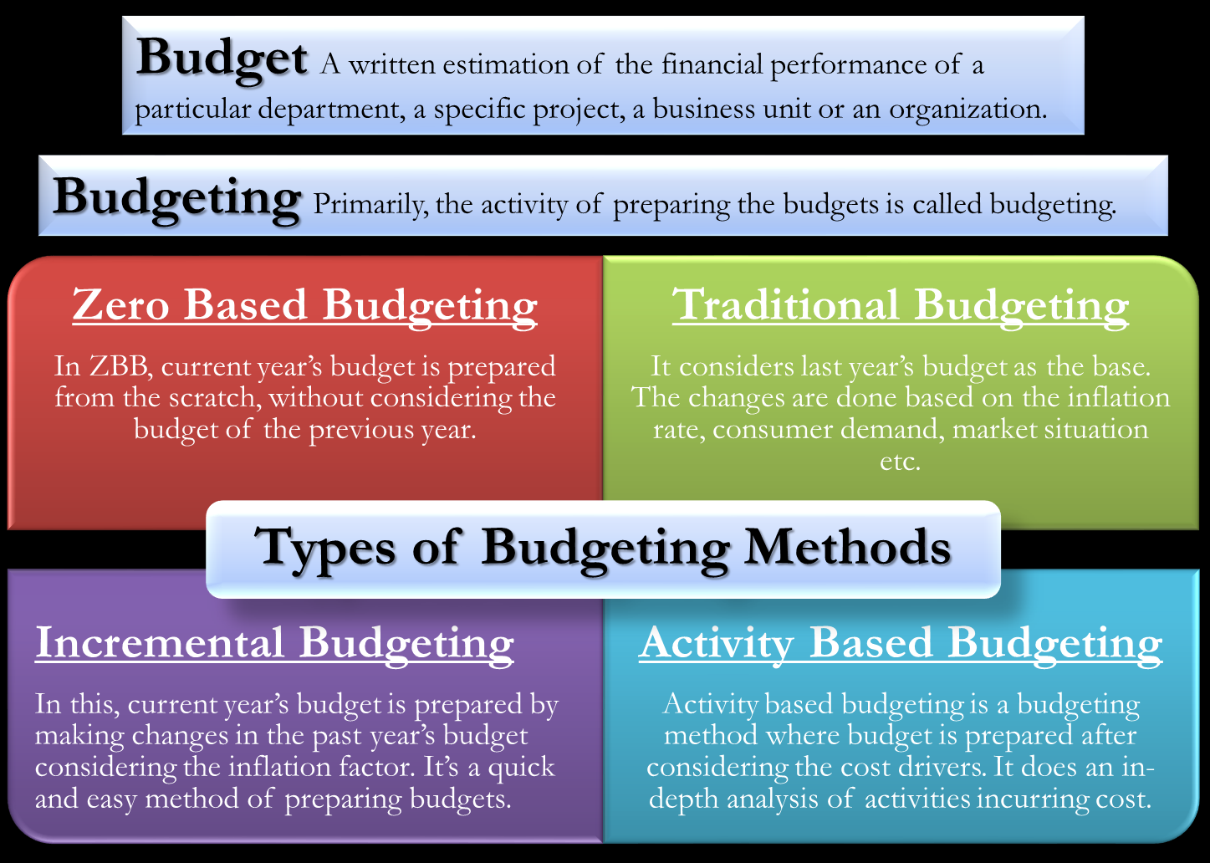
What is a (project/activity) budget?
How is the LCAP budgeted?
A hybrid of two methods:
* Traditional
* Activity Based
What is the Process?
Step 1: Understand the Requirements
Step 2: Define the Project/Activity
Step 3: Gather Information/
Categorize Expenses
Step 4: Estimate Costs
Step 5: Create the Budget/
Review and Revise

Slide 13
DUCKS IN A ROW…
FROM THIS…
…TO THIS
Concepts, Ideas, Desk Walk-Bys
Organized, Categorized, Documented
Accomplished by: Asking LOTS of questions!

Slide 14
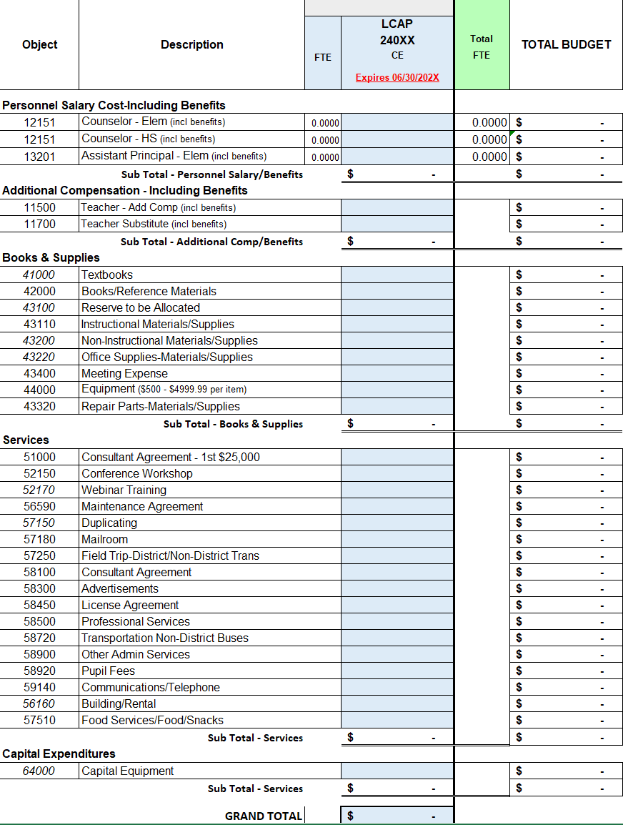
Interactive activity - INTRODUCTION
Project/Activity:
Provide engagement opportunities through meetings and events that extends communication on the LCAP, SPSAs, and district priorities.
Target Audience:
Parents, Community, Teachers, Staff, Bargaining Unions, Administrators, Students
Timeline/Period:
Jul: Planning
Aug – Nov: Meetings/Events
Dec: Planning
Jan – May: Meetings/Events
Needs/Ideas:
LCAP Survey Signs
Meeting Room
Meeting Refreshments
Brochures
Postcard Flyers
Flyer Software
Workshops/Conference
Survey subscription
And the list continues…
Clarifying Questions…
What is missing?
Is there enough details?
Is there funding to cover expense?
Am I extending past the project parameters?

Slide 15
STEP 1: UNDERSTANDING THE REQUIREMENTS
Q1: What funding source(s) applies to the constraint?
Constraints:
Limitations on purchases
Earmarked for a specific purpose
Earmarked for a specific student group
Time constraints
Specific intended purpose
Funding Source:
Base
Supplemental & Concentration
Concentration 2.0
Equity Multiplier
Title I
Title II
Title III
Title IV
CSI
ESSER III
Q2: What funding source(s) do not have a constraint?

Slide 16
Funding Source/Description | Funding Agency | Constraint/Limitation
Base: General Fund – For all purposes. | State
Supplemental & Concentration (S&C): General Fund – Provides supports to low-income students, English Learners, and Foster Youth. | State | Earmarked for a specific student group, Time constraints
Concentration 2.0 (15% Add On): General Fund – Provides staffing to school sites for direct student support. | State | Limitations on purchases, Time constraints
Equity Multiplier: General Fund – Provides supports for specific school sites with a high non-stability rate. | State | Limitations on purchases, Earmarked for a specific purpose, Time constraints
Title I – Provide student supports for low-income students who are at-risk of failing. | Federal Pass-Through | Earmarked for a specific student group, Limitations on purchases, Time constraints, Earmarked for a specific purpose
Title II – Provides teachers with professional development to enhance instructional strategies | Federal Pass-Through | Limitations on purchases, Time constraints, Earmarked for a specific purpose
Title III – Provides student and family supports for English Learner students. | Federal Pass-Through | Earmarked for a specific student group, Limitations on purchases, Time constraints, Earmarked for a specific purpose
Title IV – Provides whole child supports. | Federal Pass-Through | Limitations on purchases, Earmarked for a specific purpose, Time constraints
ESSER III – Provides supports to prevent, prepare, and/or respond to COVID-19 pandemic. | Federal Pass-Through | Limitations on purchases, Earmarked for a specific purpose, Time constraints
CSI – Provides student supports for schools who meet the criteria of low performing. | Federal Pass-Through | Limitations on purchases, Earmarked for a specific purpose, Time constraints

Slide 17
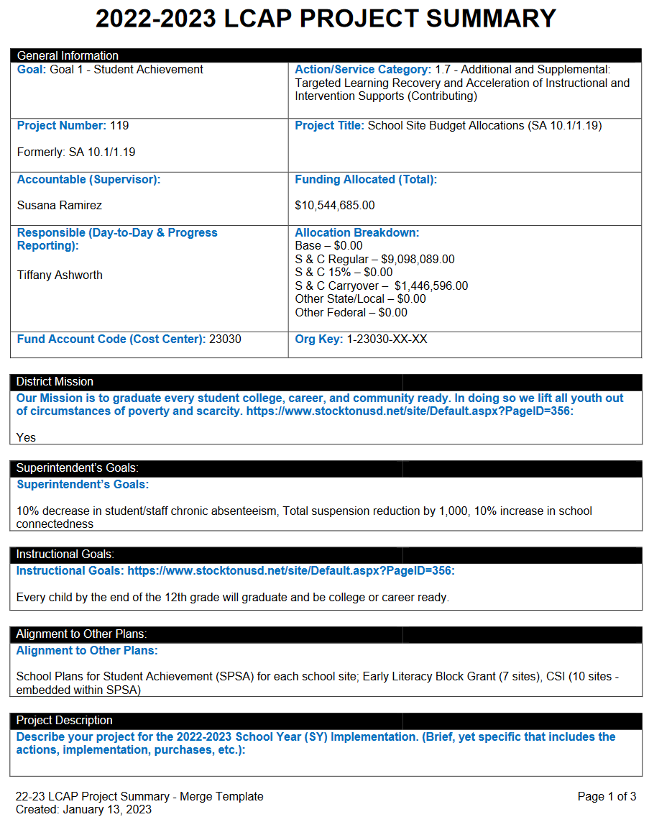
STEP 2: DEFINING the project/activity?
It ALL starts with the identification of need(s) and desired outcome(s).
After a need is identified, what activity/strategy can be implemented to achieve the desired outcome?
Internally, Project Leads are required to complete a Project Summary to describe the following:
Specific and Detailed activities to be implemented
Project Specific Performance Measures
Timeline with milestones
Targeted Student Group(s)
Project Budget

Slide 18
Interactive activity – step 2 review
Project/Activity:
Provide engagement opportunities through meetings and events that extends communication on the LCAP, SPSAs, and district priorities.
Target Audience:
Parents, Community, Teachers, Staff, Bargaining Unions, Administrators, Students
Timeline/Period:
Jul: Planning
Aug – Nov: Meetings/Events
Dec: Planning
Jan – May: Meetings/Events
Needs/Ideas:
LCAP Survey Signs
Meeting Room
Meeting Refreshments
Brochures
Postcard Flyers
Flyer Software
Workshops/Conference
Survey subscription
And the list continues…
Clarifying Questions…
What is missing?
Is there enough details?
Is there funding to cover expense?
Am I extending past the project parameters?

Slide 19
STEP 3: GATHER INFORMATION & CATEGORIZE
Staffing/Positions – 3 year projection, step & column increase, COLA, benefit rate increase, bargaining agreement stipulations Recruitment – staff in place, new position
Materials/Supplies/Equipment – cost, availability, disposal, depreciation, consumable
Conferences/Workshops/Trainings – registration, lodging, transportation, meals, parking, substitute coverage, mileage
Consultants/Professional Services – cost for services
Procurement – quotes – formal/informal, go out to bid

Slide 20
Interactive activity – step 3 review
Project/Activity:
Provide engagement opportunities through meetings and events that extends communication on the LCAP, SPSAs, and district priorities.
Target Audience:
Parents, Community, Teachers, Staff, Bargaining Unions, Administrators, Students
Timeline/Period:
Jul: Planning
Aug – Nov: Meetings/Events
Dec: Planning
Jan – May: Meetings/Events
Needs/Ideas:
LCAP Survey Signs
Meeting Room
Meeting Refreshments
Brochures
Postcard Flyers
Flyer Software
Workshops/Conference
Survey subscription
And the list continues…
Clarifying Questions…
What is missing?
Is there enough details?
Is there funding to cover expense?
Am I extending past the project parameters?

Slide 21
STEP 4: Estimate costs
Staffing/Positions – Work with Business Services for cost projections
Consultants/Professional Services – Work with Purchasing for fee schedule, request for proposal (go out to bid)
Materials/Supplies/Equipment – Work with Purchasing for catalog, website, vendor quote
Conferences/Workshops/Trainings – Registration, lodging, transportation, meals, parking, substitute coverage
Procurement – Work with Purchasing – quotes – formal/informal, go out to bid
Estimates Are NOT…
Random
Guesses
Estimates ARE Based on…
Facts
Data
Trends
What does it look like with your personal (home) budget?

Slide 22
Interactive activity – step 4 review
Project/Activity:
Provide engagement opportunities through meetings and events that extends communication on the LCAP, SPSAs, and district priorities.
Target Audience:
Parents, Community, Teachers, Staff, Bargaining Unions, Administrators, Students
Timeline/Period:
Jul: Planning
Aug – Nov: Meetings/Events
Dec: Planning
Jan – May: Meetings/Events
Needs/Ideas:
LCAP Survey Signs
Meeting Room
Meeting Refreshments
Brochures
Postcard Flyers
Flyer Software
Workshops/Conference
Survey subscription
And the list continues…
Clarifying Questions…
What is missing?
Is there enough details?
Is there funding to cover expense?
Am I extending past the project parameters?

Slide 23
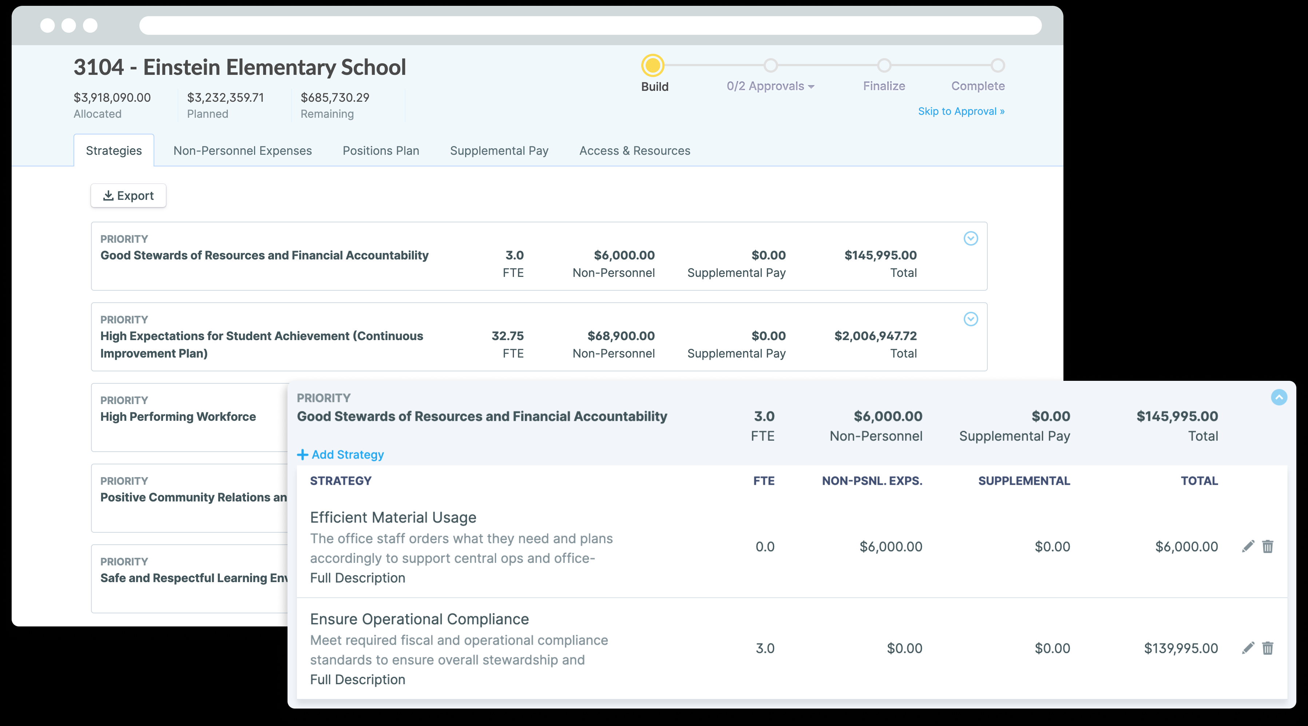
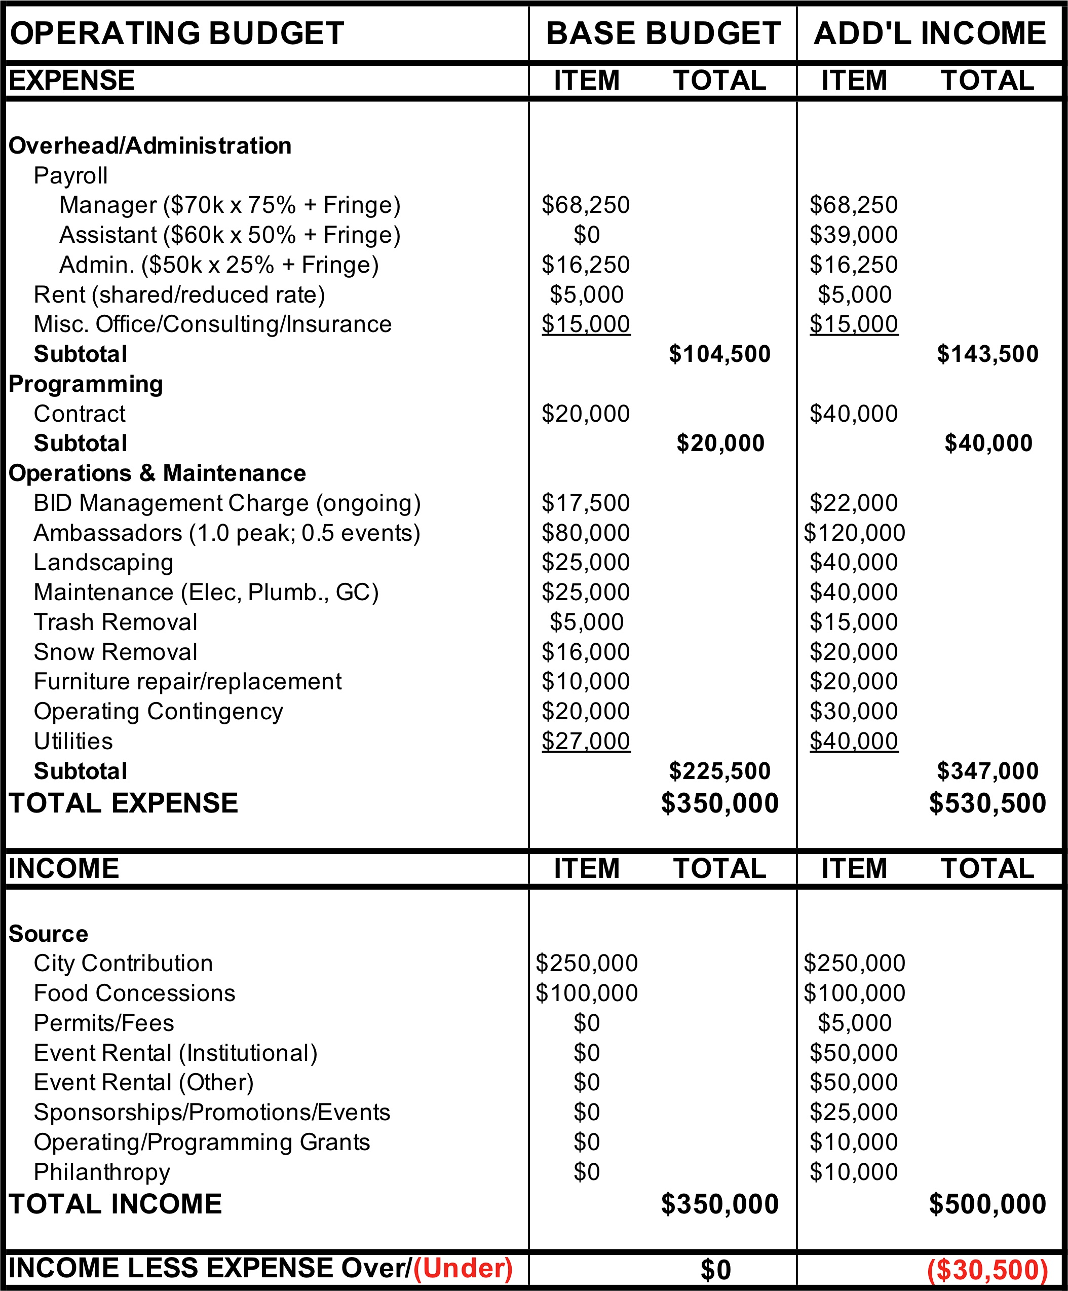
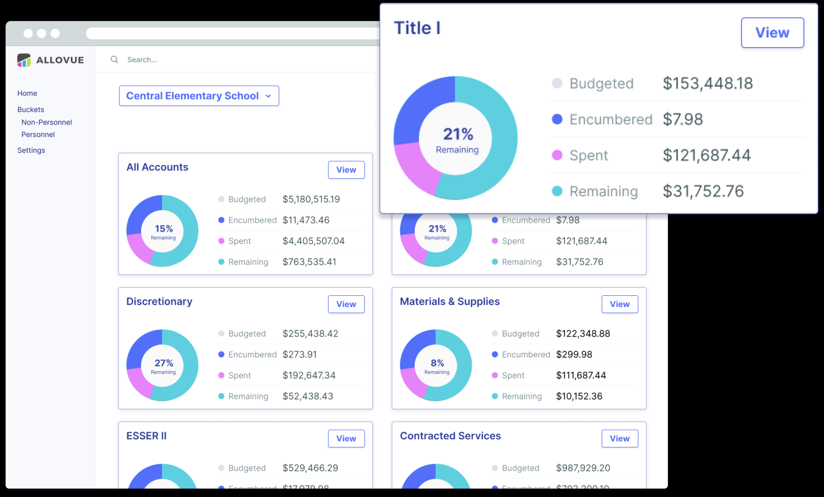
STEP 5: CREATE THE BUDGET / REVIEW / REVISE
Budget Format:
Many different ways to express a budget.
Written plan of future expenditure.
Typically in Excel (spreadsheet) for formulas and totaling
At-A-Glance View (1+ Yrs.)
Static vs Dynamic

Slide 24
Interactive activity – debrief
Project/Activity:
Provide engagement opportunities through meetings and events that extends communication on the LCAP, SPSAs, and district priorities.
Target Audience:
Parents, Community, Teachers, Staff, Bargaining Unions, Administrators, Students
Timeline/Period:
Jul: Planning
Aug – Nov: Meetings/Events
Dec: Planning
Jan – May: Meetings/Events
Needs/Ideas:
LCAP Survey Signs
Meeting Room
Meeting Refreshments
Brochures
Postcard Flyers
Flyer Software
Workshops/Conference
Survey subscription
And the list continues…
Clarifying Questions…
What is missing?
Is there enough details?
Is there funding to cover expense?
Am I extending past the project parameters?

Slide 25
Next lcap engagement session
FOCUSED TOPIC:
Survey Results and Key Findings
DATE:
March 5, 2024
TIME:
9:00 a.m. – 10:30 a.m. – Zoom (https://us06web.zoom.us/j/88016804412)
5:30 p.m. – 7:00 p.m. – In Person @ Chavez High

Slide 26
LCAP Engagement in 2023-2024
11/28: Introduction: LCAP Fundamentals
12/04: Current District Priorities – 2023-2024 School Year
01/19: LCAP Mid-Year Update and Funding
02/09: Data Analysis / District Areas of Need
02/16: Budget Projections
03/05: Survey Results and Key Findings
03/08: Identified District Goals/Activities
* April 2024: Post Draft 2024-2027 LCAP
* May 2024: Public Hearing 2024-2027 LCAP
* June 2024: Board Adoption 2024-2027 LCAP

Slide 27
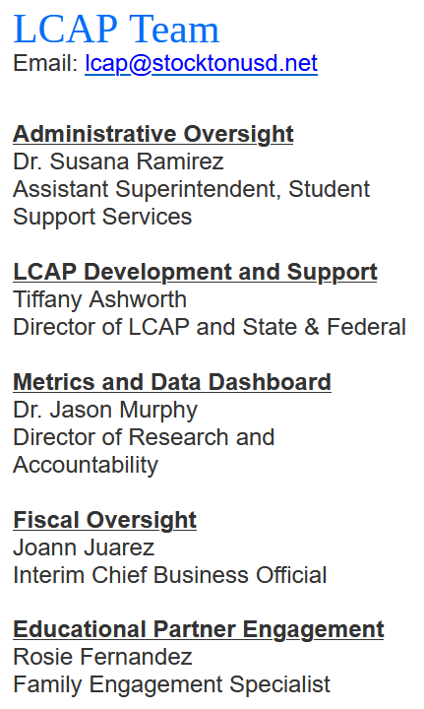
THANK YOU!

